Slide 1
Smart Curtain System
Team 3N3

Slide 2





Meet the Team
Arthur Chen, ‘22
Project Leader
David Erdner, ‘22
Systems Design
James Streets ‘22
Hardware Design
Pierre Vu, ‘22
Software Design
Caleb Key, ‘22
Testing, Technical Reporting
Notes:
https://crop-circle.imageonline.co/

Slide 3
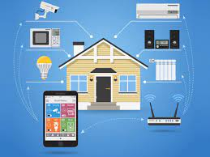
Project Scope
Automation
Home electronics
Indoor climate control

Slide 4

Goal of the smart curtain
Automatically control curtains
Measure environment
Control temperature

Slide 5

Design Constraints
Aesthetic Design
Safety
Mounting
Electronics
Clearance

Slide 6
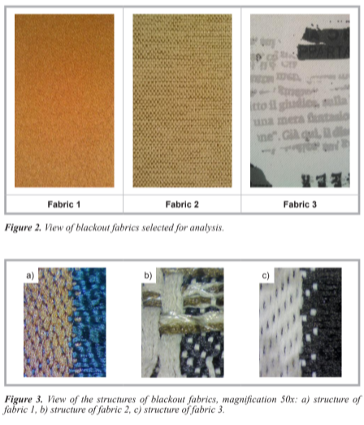
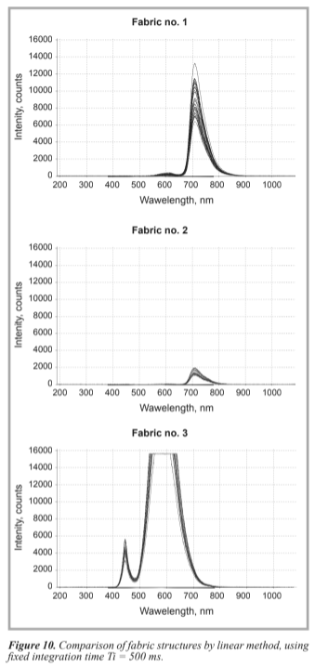
Literature Review - Research Projects
Proposal of Objective Assessment of the Phenomenon of Light Passage through Blackout Fabrics by Joanna Szk
Study on the influence of key parameters of exterior window structure on building energy saving effect by Mengting Zhu et al
Key takeaways for our project:
Indoor temperature influenced by outdoor temperature, delayed by 0-2 hours.
Common exterior window transmits 85% of total heat radiation from the sun

Slide 7
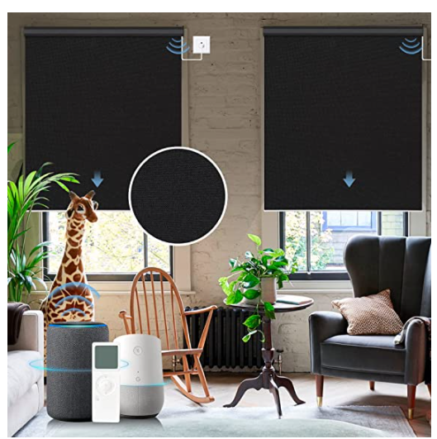
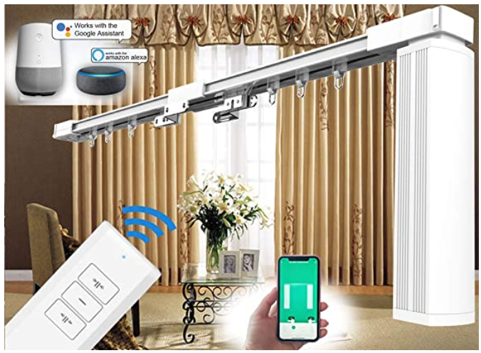
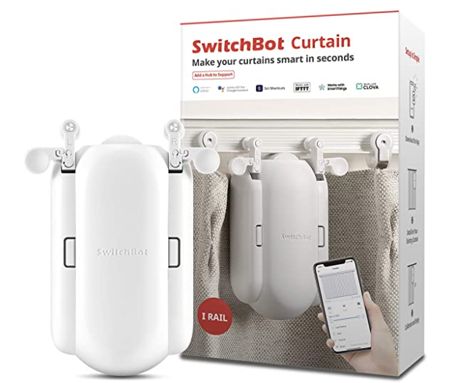
Literature Review - Existing Products
GrayWind
SimpleSmart
SmartBot

Slide 8
Existing Solutions
Assessment of the Light Passage through Blackout Fabrics
Influence of exterior window structure on energy saving
Graywind Motorized Shades
SimpleSmart - Motorized Curtain Tracks
SwitchBot Curtain Smart Electric Motor

Slide 9
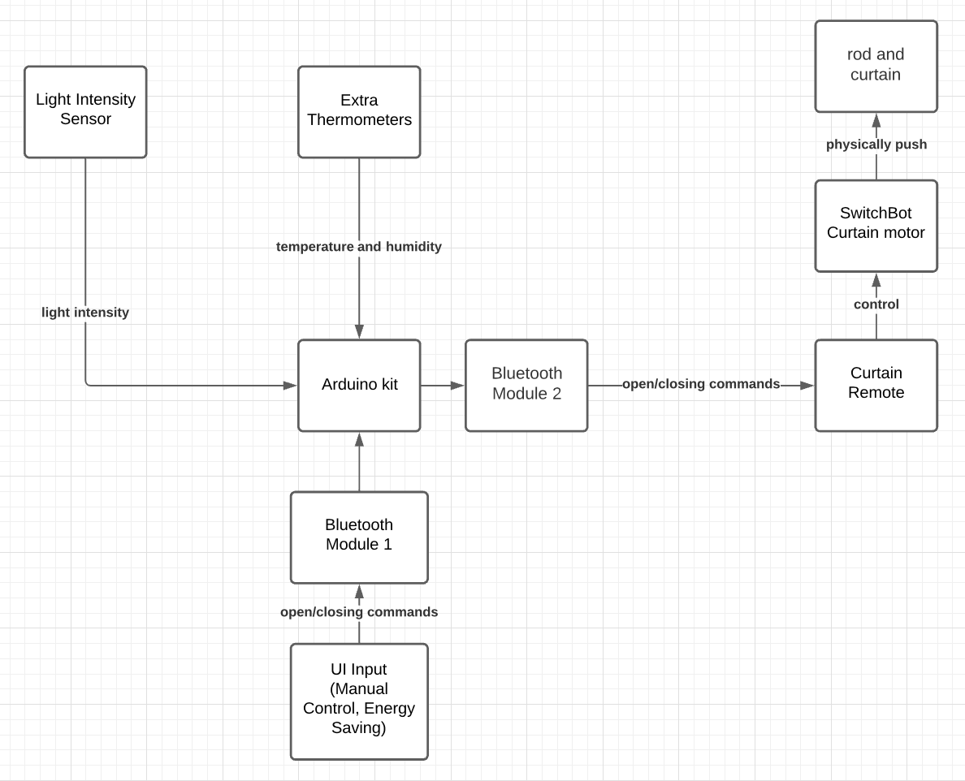
High level design of the smart curtain

Slide 10
Validation process
Test functionalities first
Monitor the curtain in a controlled environment
Calculate the energy from the Sun during the period
Convert to electricity saved

Slide 11
How we manage the project
5 Main Roles:
Team Leader
System Designer
Software Designer
Hardware Designer
Testing
Each person will be mainly responsible for one role
Everyone expected to contribute to each part of the project (eg. Software designer can also help with hardware when needed)
Gantt and Flow Charts for task and schedule management

Slide 12
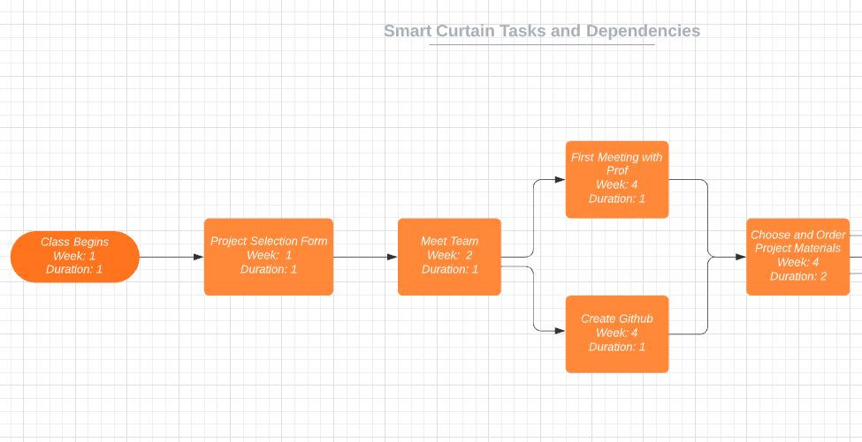
Task and Schedule Flow Chart

Slide 13
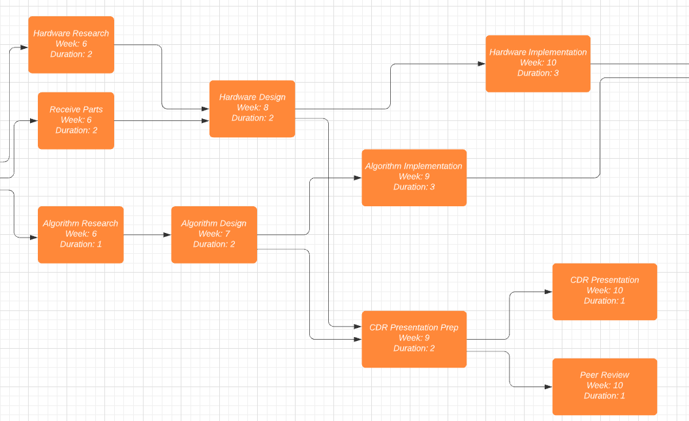
Task and Schedule Flow Chart (cont. )

Slide 14
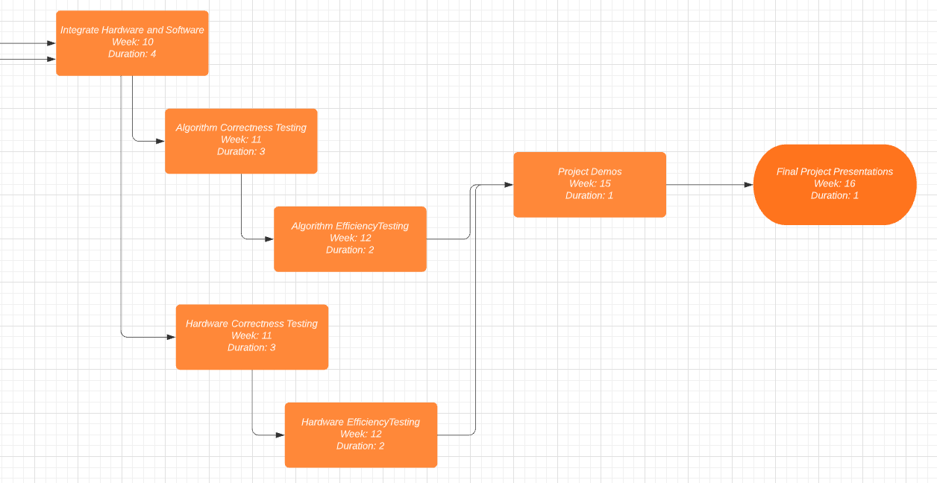
Task and Schedule Flow Chart (cont. )

Slide 15
The cost of the project
Over $300 under budget.
Room to order more parts if some components break/don’t work
Component | Price
Arduino kit | $38.99
SwitchBot Curtain motor | $99.00
Curtain Remote | $16.15
Extra Thermometers | $10.29
Light Intensity Sensor | $10.99
Bluetooth Module for Arduino (2) | $18.00
Rod for holding curtains | $19.00
Black Out curtains | $16.00
Total | $228.42

Slide 16
Conclusion
The Smart Curtain System is the next step in Smart Home improvements
Our product will save energy by reducing workload of AC Unit
Adds next level of home convenience and worry free power management

Slide 17
Questions?

